Slide 1
Images to build knowledge of the world of the people of 1381
Teacher pages = blue background; pupil resources = white background
Notes:
For further medieval images see: https://www.ashmolean.org/learning-resource-medieval-world
To read about how and why we ‘world-build’ for secure knowledge in history go to: https://www.history.org.uk/publications/resource/9922/curating-the-imagined-past-world-building-in-the

Slide 2
What is this resource?
Here are 12 images and 12 accompanying descriptions that can be used to ‘world-build’ the later Middle Ages in England. If students are to make historical sense of the events and people of the time, they need to have:
Knowledge of the material world in which the people lived
Knowledge of what they believed and thought
Knowledge of what was and was not possible in their world
Working with these images and descriptions before teaching specific topics will give students a mental framework – a sense of the world at the time – to help them to secure knowledge of specific events and people.
Note: for copyright reasons, some of the image slides are a link to where you can go to download the image for classroom use.

Slide 3
How do I teach using this resource?
Print off and give pairs of students the 12 images.
Give students time to study the images and to discuss the questions on the next slide.
Then give students the descriptions of the images. Ask them to match the images and descriptions and to read the latter.
Discuss as a class what we have learnt about the world of the people of England in around the year 1381. Examples of questions: What was important to people? Who had power over people? How capable were these people? What did their world look like?

Slide 4
Questions for students to use with the images
What can you see?
Where and when was it produced?
What is it made from?
What can you learn from it about living in England in the later Middle Ages?

Slide 5
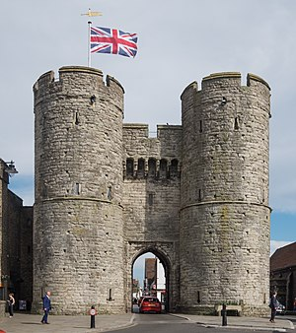
The Westgate, Canterbury, ordered to be built in 1380 by Archbishop Simon Sudbury
Notes:
Image: https://en.wikipedia.org/wiki/Westgate,_Canterbury

Slide 6
The Westgate, Canterbury – built in 1380
Canterbury is in the south-east of England. In 1380, it was expected that a French army would invade southern England. The Westgate was rebuilt to protect the city of Canterbury in case there was a French attack. It was partly paid for from taxes.
The Archbishop was the most powerful person in Canterbury. Simon Sudbury was one of the King’s leading advisers, as well as an archbishop.
Notes:
Source: https://en.wikipedia.org/wiki/Westgate,_Canterbury

Slide 7
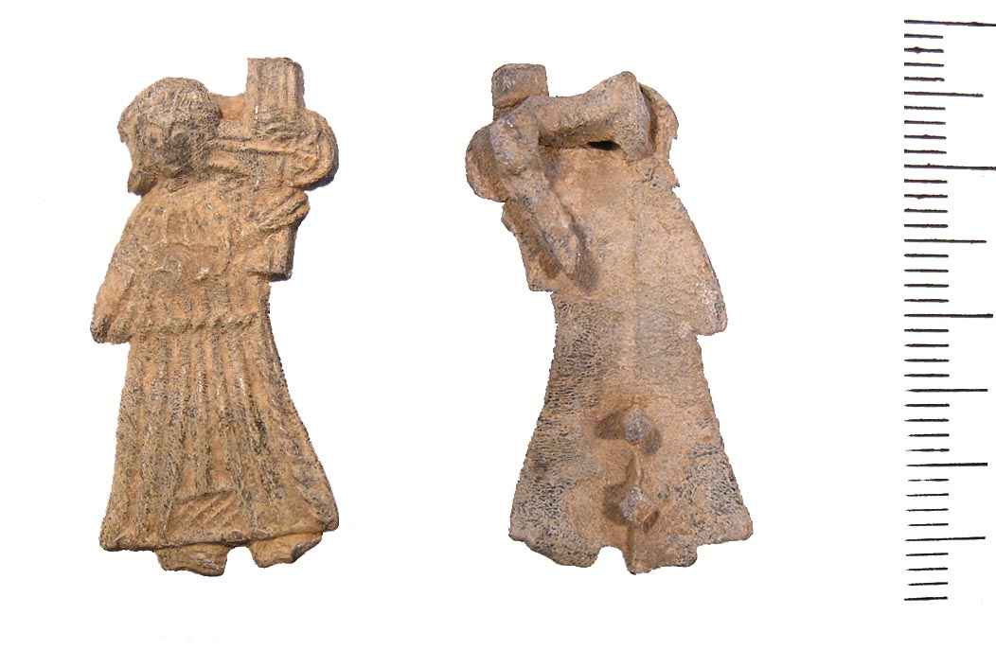
Pilgrim badge (early 1400s)
Notes:
Image: https://commons.wikimedia.org/wiki/File:Lead_Alloy_medieval_pilgrim_badge_%28FindID_461379%29.jpg

Slide 8
Pilgrim badge (early 1400s)
Badges like this one were collected by pilgrims. Pilgrims were people who went on journeys, called pilgrimages, to the shrines of saints. These shrines were places linked to saints – for example, where they were buried. Many pilgrimages were made by people in the Middle Ages. Sometimes pilgrimages were to local shrines. Sometimes pilgrimages were made by walking long distances. For example, many English people travelled by sea and on foot to the shrine of St James at Compostela in northern Spain.
These badges were a sign that the person who wore it had made a pilgrimage. They would be worn on a hat or a jacket, rather like people might wear a badge today.
The most important shrine in England was the shrine of St Thomas Becket at Canterbury. Over 100,000 pilgrims visited St Thomas’s shrine each year. Going on pilgrimage was very popular.

Slide 9
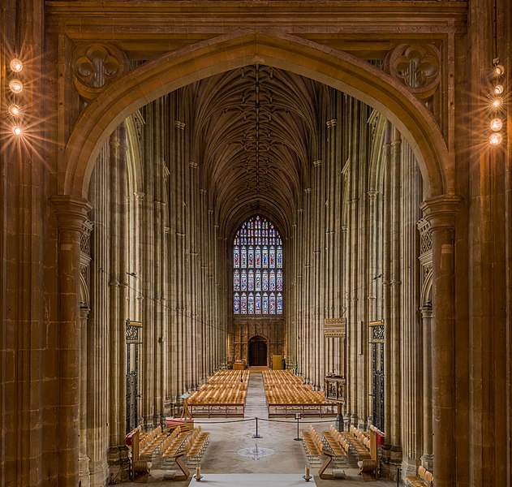
The nave of Canterbury Cathedral, built 1377–1405
Notes:
Image: https://en.wikipedia.org/wiki/File:Canterbury_Cathedral_Nave_1,_Kent,_UK_-_Diliff.jpg

Slide 10
The nave of Canterbury Cathedral, built 1377–1405
Canterbury was the most important cathedral in England. It was also the place of the shrine of England’s most important saint, Thomas Becket.
The nave part of the cathedral was rebuilt between 1377 and1405 in the latest, most fashionable ‘gothic’ style. Skilled builders, stonemasons and glaziers (supported by many less-skilled workers) created a building that was designed to be breath-taking. At the time, most people lived in low-rise houses. There was nothing but horse-power to help with the moving and lifting.
The gothic style shows the influence of French tastes and fashion on English architecture at the time.
The rebuilding was probably funded by the Church, local merchants and donations from pilgrims to the shrine of St Thomas. Giving money to the rebuilding was thought to help a wealthy person to avoid going to hell when they died.

Slide 11
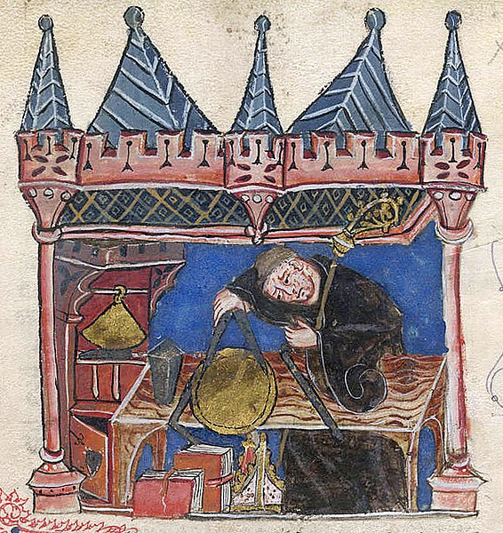
Richard of Wallingford at work
Notes:
Image: https://commons.wikimedia.org/wiki/File:Richard_of_Wallingford.jpg

Slide 12
Richard of Wallingford at work
Richard was the son of a blacksmith. His father died and Richard was put under the care of monks. He then studied at Oxford University, before becoming a monk himself. After more study at Oxford, he became the Abbot of St Albans Abbey. Richard suffered from a disability caused by an infectious disease.
We know that Richard made his own mechanical astronomical clock. This sort of clock maps the position of the earth, the sun, the moon and other planets. Richard’s clock is lost, but we know that it showed the phases of the moon, sun positions and the height of the tide in London.
Richard also made machines to carry out mathematical calculations. One of these, called Albion, could be used to predict eclipses.

Slide 13
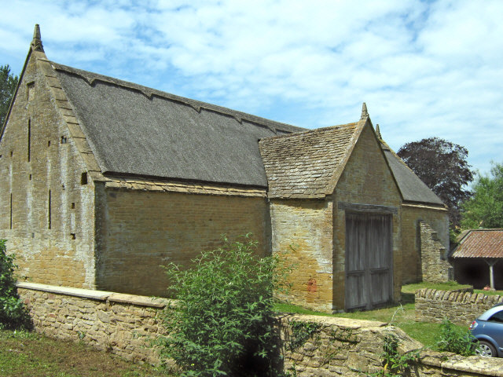
Stoke sub Hamdon Priory and Tithe Barn, 1304
Notes:
Image: https://en.wikipedia.org/wiki/Stoke_sub_Hamdon_Priory#/media/File:The_old_barn,_Stoke_sub_Hamdon_Priory_-_geograph.org.uk_-_1380654.jpg

Slide 14
Stoke sub Hamdon Priory and Tithe Barn, 1304
This is a tithe barn in the centre of the village of Stoke Under Ham in Somerset. It was built in 1304. It was owned by the Church.
The Church collected the tithe every year. It was 10% of what a person earned or produced. Tithes were different from taxes paid to the King or lord of the manor.
This barn is as long as two tennis courts and it would have stored the grain and other produce collected from villagers. The barn was built of fine stone and was also a place where the villagers had celebrations on Holy Days (holidays).

Slide 15
Part of the Gough Map, probably made in the 1370s: www.goughmap.org

Slide 16
Part of the Gough Map, probably made in the 1370s
This is a section of the Gough Map, now in the Bodleian Library in Oxford. The Gough Map is one of the earliest maps to show Britain in a geographically recognisable form. By looking at it we can infer all sorts of fascinating things about the place and the people at the time. For example, we can see which towns and cities were most important. We can see where there were castles. We can even see Hadrian’s Wall. The map-maker has included the sea and the rivers (in a greenish colour). The rivers and the coastal routes were an important way to travel, especially when moving goods or when the roads were impassable due to mud.

Slide 17
Fourteenth-century shoe found in London: https://collections.museumoflondon.org.uk/online/object/32682.html

Slide 18
Fourteenth-century shoe found in London
This hand-made leather shoe would have been made by a cordwainer. Cordwainers made shoes and cobblers repaired shoes. The person who wore these shoes probably also wore pattens. Pattens were wooden overshoes that were worn in the street. The wooden pattens protected the leather shoes from dirt and wear.
This is a fashionable shoe with a pointed toe that was stuffed with moss. In the later Middle Ages, there were laws about what people could wear. People of lower status were not allowed to wear certain clothes, colours or styles.

Slide 19
Queen Mary Psalter image of women catching rabbits: www.bl.uk/collection-items/the-queen-mary-psalter

Slide 20
Queen Mary Psalter image of women catching rabbits
This is an image from the Queen Mary Psalter. A psalter was a prayer book. It would have been written and illustrated by hand. That made it an expensive item. It would have belonged to a wealthy person.
This psalter shows many scenes of rural life in England in the 1300s, and is particularly rich in images of women. Partly because of this, many academics think that it was owned by Queen Isabella of France, the wife of Edward II.
In this image from the psalter, two peasant women hunt rabbits using ferrets and nets. The psalter also has images of women in childbirth and of female saints.

Slide 21
St Albans’ clock tower, built in 1405: www.stalbansmuseums.org.uk/visit/clock-tower

Slide 22
St Albans’ clock tower, built in 1405
St Albans’ clock tower is a belfry. A belfry holds bells, and we usually think of them as part of old churches. This belfry is not part of a church. It was built by the townspeople of St Albans in 1405. The people of St Albans disliked the power of St Albans Abbey and its leader, the Abbot. They built this belfry so that they could ring bells on the hour. This meant that they did not have to rely on the Abbey bells to know what time it was. The belfry bells were also rung at a certain time each evening to tell people that they should be at home. This was known as the curfew.

Slide 23
English in the 1300s: an extract from The Miller’s Tale by Geoffrey Chaucer
Now was ther of that chirche a parissh clerk, The which that was ycleped Absolon. Crul was his heer, and as the gold it shoon, And strouted as a fanne large and brode; Ful streight and evene lay his joly shode;…
A myrie child he was, so God me save. Wel koude he laten blood and clippe and shave, And maken a chartre of lond or acquitaunce. In twenty manere koude he trippe and daunce…
And as wel koude he pleye on a giterne. In al the toun nas brewhous ne taverne That he ne visited with his solas, Ther any gaylard tappestere was. But sooth to seyn, he was somdeel squaymous Of fartyng, and of speche daungerous.

Slide 24
English in the 1300s: an extract from The Miller’s Tale by Geoffrey Chaucer
‘Now there was of that church a parish clerk, Whose name was (as folk called him) Absalom. Curled was his hair, shining like gold, and from His head spread fanwise in a thick bright mop;...
A merry lad he was, so God me save, And well could he let blood, cut hair, and shave, [and write out a legal document]. In twenty manners could he trip and dance...
And as well could he play on his guitar. In all the town no inn was, and no bar, That he’d not visited to make good cheer, Especially were lively barmaids there. But, truth to tell, he was a bit squeamish Of farting and of arrogant language.’
Geoffrey Chaucer wrote this tale as part of his Canterbury Tales from 1387 to 1400. The tales are told by pilgrims travelling on the road together on their way to the shrine of St Thomas Becket in Canterbury Cathedral. The Tales were a ‘bestseller’ in their time. They reveal that people were opinionated, loved fun and were not afraid to criticise powerful people and ideas.

Slide 25
A medieval wool weight: www.bbc.co.uk/ahistoryoftheworld/objects/u15REJ1zT8eoUmBKfORK9w

Slide 26
A medieval wool weight
The weight is from Lincoln. It shows the old symbol of the Kingdom of England, known as the coat of arms. People in the city made scarlet cloth. They traded with merchants from Venice and Florence in Italy.
Wool and cloth were important products that were made in England and traded at home and abroad. The wool and cloth trade was very important to the economy. If the economy was doing well, the King could raise taxes more easily.
War with France from the mid-fourteenth century changed the wool trade. England traded less with France and more with the area that is now the Netherlands and Belgium. The area around the town of Ypres, known as Flanders, was not so peaceful. Therefore, wool workers were encouraged to move to England to continue their business. England began to trade more cloth than wool, including to Polish and German towns.

Slide 27
The Butler-Bowdon Cope, made in 1335–45: https://collections.vam.ac.uk/item/O93441/butler-bowdon-cope-cope-unknown

Slide 28
The Butler-Bowdon Cope, made in 1335–45
A cope is a cloak made for use in church services and processions. This cope would have cost a lot of money. It is made from the finest materials available at the time. The red velvet came from Italy. The needlework was carried out by English embroiderers. English embroidery was prized as the most beautiful and skilful.
The cope might have been paid for by a wealthy person who wanted to show their devotion to the Church.
The church person who wore the cope would have been making a big show of both the Church’s earthly wealth, and the importance of every person praying, going to church and being loyal to the Church, so that they would go to heaven. This cope therefore tells us a lot about the power, wealth and authority of the Church, and of the (mostly) men who were leaders in the church.

